Slide 1
Module 3 Part 2
Single Cycle Data Path - Multi Cycle Data Path

Slide 2
Data Path Architecture Introduction

Slide 3
Data Path Architecture
Highest Level : Program
.
.
.
Lowest Level : State
At each state small activity happens
(RTL Activities)
(Register Transfer Level Activities)
RTL: The Sequence in which the register transfer actions should take place will be decided by the controller

Slide 4
Data Path Architecture
Activity consist of
i) Data Path : How a data travels inside the processor from one component to a another component
ii) Control (Controlling the Data Path): Who is controlling the data and who decides which path it has to take

Slide 5
Data Path Typical Architecture
1. Architecture means : grouping various components together whenever the processor needs
2. Controller will issue appropriate signals
3. Physical connections will be enabled
4. That data will move around

Slide 6
Components of Data Path Architecture
Multiplexer
ALU
Registers

Slide 7
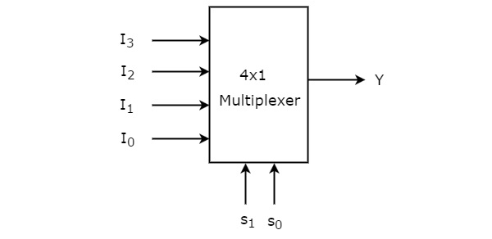
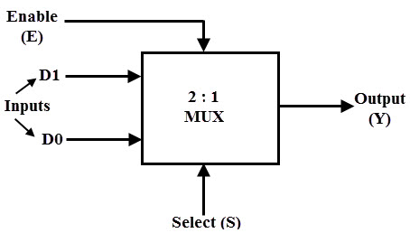
Multiplexer
Multiple inputs
One output
Which one output from many inputs will be selected, will be decided by the select line (otherwise called as controller).

Slide 8
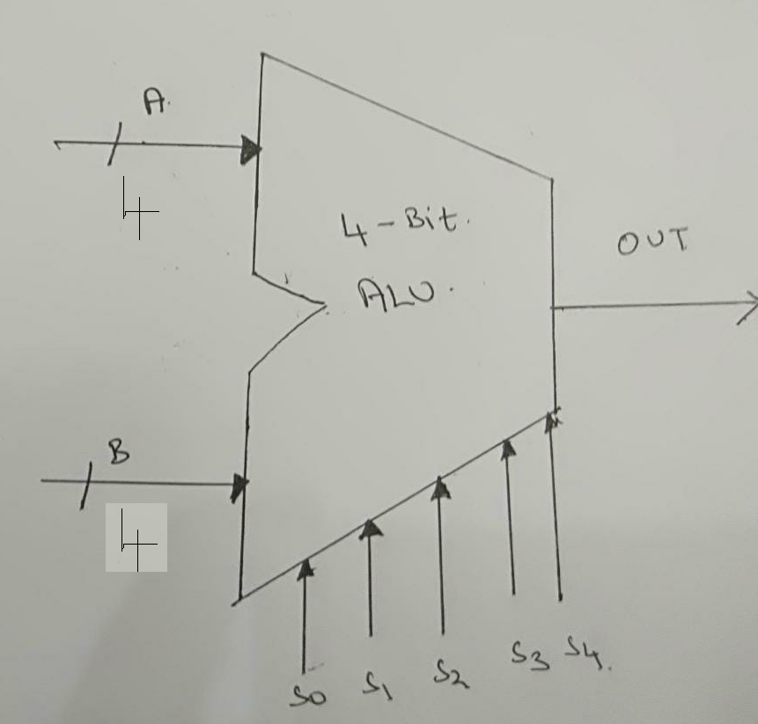
ALU (Arithmetic and Logic Unit)
For example, a 32 ALU can perform:
16 Arithmetic Operations
16 Logical Operations
5 bit control lines to select any one of the ALU operations
ALU performs the role of both Mux and ALU

Slide 9
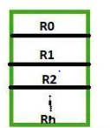
Registers
General Purpose Registers (GPR) are the ones which stores the data on the processors side
Example, R₀, R₁, R₂… R_{n}

Slide 10
Single Cycle Data Path Architecture

Slide 11
Execution of Complete Instruction Using Single Cycle Data Path
The whole control sequence for the instruction( ins) execution Add R₁ , (R₂) for the single cycle data path is considered
The value of the register (reg) R₁ and the value of the memory location indicated by the reg R₂ is added
The result is stored in the register R₁

Slide 12
Execution of Single Cycle Data Path(Conti..)
To execute the Add R₁ , (R₂) instruction the following actions are necessary
Obtain the instruction from the memory location
Obtain the operand from the memory location directed by R₂
Carry out the ALU operation indicated by the instruction (i.e add in this example)
Store the end result in R₁

Slide 13
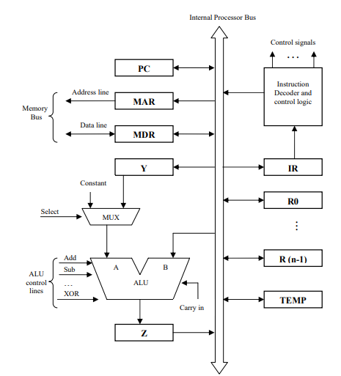
Figure 1. Single Cycle Data Path Architecture
Reference: Hamacher, C., Vranesic, Z., & Zaky, S. (2002). Computer organization. McGraw-Hill.

Slide 14
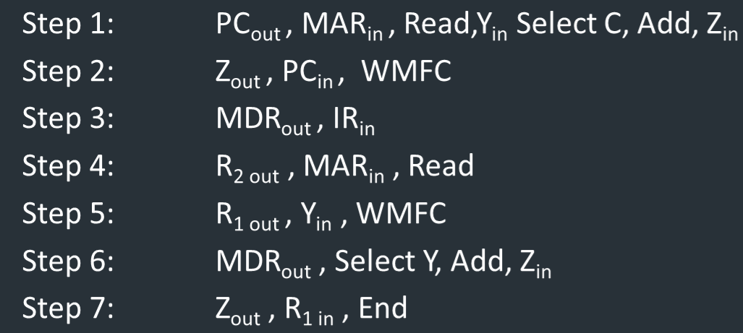
Sequence of control steps using single cycle for Add R₁ , (R₂)
Reference: Hamacher, C., Vranesic, Z., & Zaky, S. (2002). Computer organization. McGraw-Hill.

Slide 15
Control steps - Add R₁ , (R₂) - Explanation
Step1: The inst fetch step is performed by placing the value of the PC in MAR and Read signal is activated PC → MAR
At the same instance, PC value are also placed in Y reg and added with const integer by triggering the select C i/p of mux and add i/p of the ALU PC→PC+1
When Z_{in} signal is activated the output is put in Z reg CONSTANT → Z

Slide 16
Control steps - Add R₁ , (R₂) - Explanation
Step2: The Z reg value are moved to PC reg by actuating Z_{out} and PC _{in}
signal Z → PC
By doing this, PC increment process is completed and PC will indicate to next inst
WMFC: Wait Till Memory Function Complete, will wait till memory replies the request of fetch instruction to the processor. WMFC
Once WMFC signal is received from the memory , the contents of the specified location are available in MDR register inside the processor

Slide 17
Control steps - Add R₁ , (R₂) - Explanation
Step3: The contents of register MDR are moved to reg IR of the CPU MDR → IR
Step 1, 2 and 3 forms the inst fetch stage
In Step 4, inst decoder decodes the IR contents
Step 4, 5, 6, and 7 forms the instruction execution phase

Slide 18
Control steps - Add R₁ , (R₂) - Explanation
Step4: The value of reg R₂ are moved to MAR , by actuating R_{2, out} & MAR_{in} signal R₂→ MAR
Read signal is activated

Slide 19
Control steps - Add R₁ , (R₂) - Explanation
Step5: Reg R₁ value are moved to Y reg by actuating R_{1, out} and Y_{in} signal R₁→ Y
After WMFC signal is received , the contents of the specified location are available in MDR

Slide 20
Control steps - Add R₁ , (R₂) - Explanation
Step6: MDR _{out}, select Y, Add and Z_{in} signals are actuated to perform by adding of values of reg Y and MDR. MDR→ Z _{in}
Step7: The contents of register Z are moved to R₁ Z→R₁
End function triggers a new inst to take the new instruction fetch cycle to begin

Slide 21
Multi Cycle Data Path Architecture

Slide 22
Why Multi Cycle Data Path ?
In a single cycle data path architecture , exclusively single data word could be moved through the bus in a given clock cycle
Because of this no of steps needed to execute the instruction increases
To decrease the no of steps needed to execute the inst and to transfer more than one word in a clock cycle we go for multicycle

Slide 23
How Multi Cycle Data Path Works
Three buses are use to link reg and ALU of the CPU
All GPR ,
R₁, R₂…R_{n} are presented in one block known as reg files
Figure 2. shows the register files has three ports

Slide 24
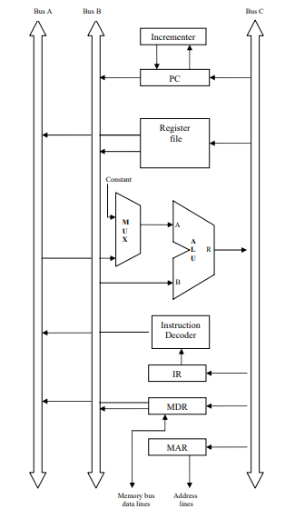
Figure 2. Multi Cycle Data Path Architecture
Reference: Hamacher, C., Vranesic, Z., & Zaky, S. (2002). Computer organization. McGraw-Hill.

Slide 25
How Multi Cycle Data Path Works
One input and two output ports for the register file
Therefore data of three registers are possible to access in single clk cycle
Through Bus C, the value could be put in one reg
Data from two regs is available through Bus A and Bus B

Slide 26
How Multi Cycle Data Path Works
Bus A and B are used to move the source operands to i/ps of the ALU A and B
After ALU process is executed the resultant is moved to destination operand through the bus C
Separate incremental unit is provided to increment the value of PC after every instruction is executed

Slide 27
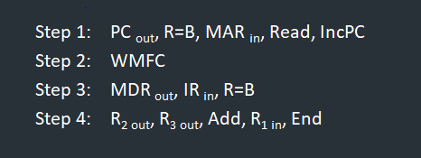
Execution of Instruction using Multi Cycle Data Path Add R₁, R₂, R₃ Control Sequence
The inst adds the values of register R₂ & R₃ and stores the resultant in R₁
Reference: Hamacher, C., Vranesic, Z., & Zaky, S. (2002). Computer organization. McGraw-Hill.

Slide 28
Multi Cycle Data Path Add R₁, R₂, R₃ Control Sequence Explanation
Step 1: The value of the PC are moved to MAR by means of Bus B to begin Read operation. PC→MAR
Parallelly PC is incremented point towards the next instruction PC→PC+1

Slide 29
Multi Cycle Data Path Add R₁, R₂, R₃ Control Sequence Explanation
Step 2: The processor waits for WMFC signal from the memory
Step 3: The inst code is moved from MDR to IR MDR→ IR
Step 4: The inst decoder decodes the IR contents

Slide 30
Multi Cycle Data Path Add R₁, R₂, R₃ Control Sequence Explanation
Step 4: Two values from reg R₂ & R₃ are made accessible at inputs A and B of ALU by means of Bus A & B
By activating the Add signal two inputs are added
Through Bus C the resultant is stored in R1

Slide 31
Multi Cycle Data Path Add R₁, R₂, R₃ Control Sequence Explanation
By providing more data paths it is possible to reduce number of clock cycles needed to execute an instruction

Slide 32
Any Questions ?

Slide 33
References
Hamacher, C., Vranesic, Z., & Zaky, S. (2002). Computer organization. McGraw-Hill.

Slide 34
Thank You!

